Slide 1
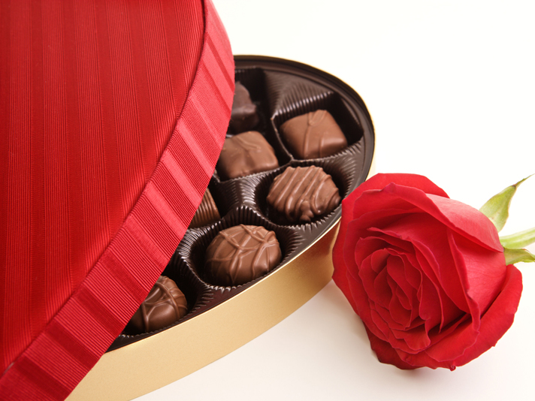
Tom and Jenny share a box of 24 chocolates in the ratio of 1:3
How many chocolates do they each get?
Tom has 6 and Jenny has 18

Slide 2
Rory, Riley and Rowan share a box of 45 chocolates in the ratio 2:3:4
How many chocolates do they each get?
Rory has 10, Riley has 15 and Rowan has 20

Slide 3
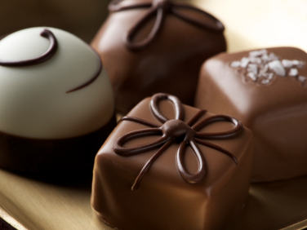
The number of milk chocolates to white chocolates in a box is in the ratio of 2:1
If there are 24 milk chocolates how many chocolates altogether?
36 (24 is the number of milk chocolates not the total)

Slide 4
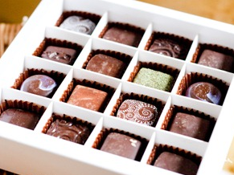
Mel, Lee and Ashton share a box of chocolates in the ratio 2:3:4
If Lee has 24 chocolates how many chocolates were there altogether?
72 (Lee has “3 parts” so 1 “part” = 8)

Slide 5
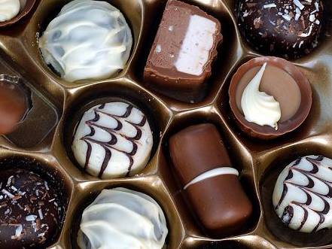
Harley, Avery and Casey share a box of chocolates in the ratio 3:5:6
If Harley has 9 chocolates how many chocolates does Avery have?
15 (Harley has “3 parts” so 1 “part” = 3)

