Slide 1
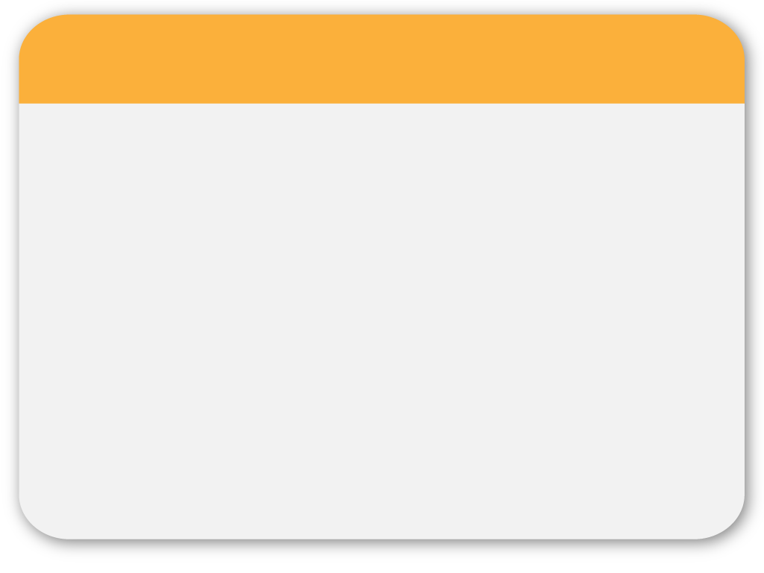
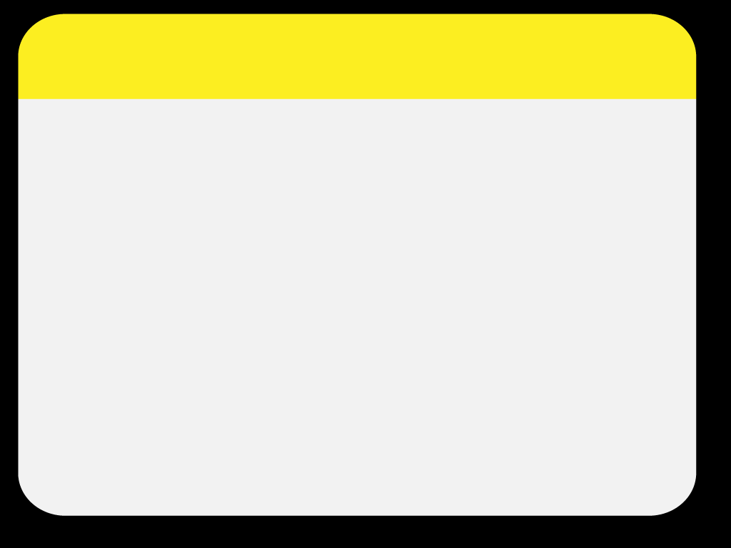
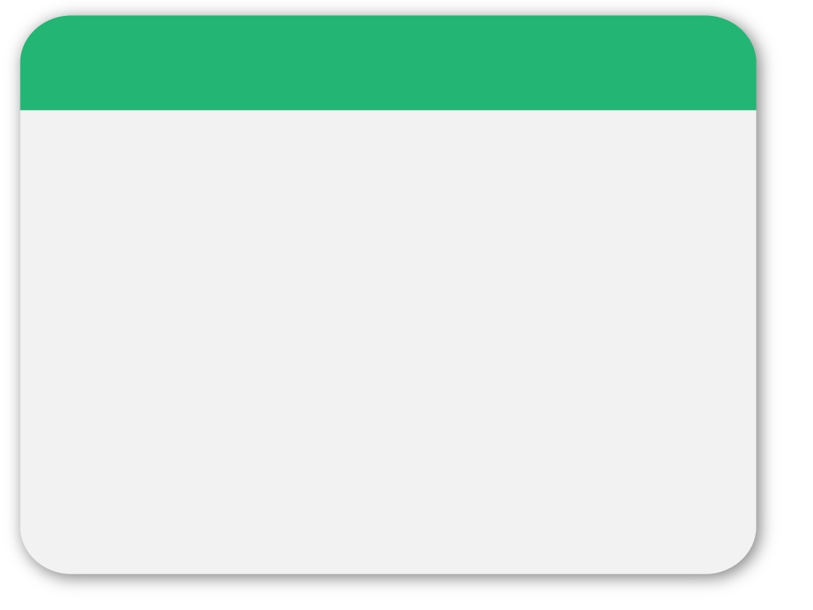
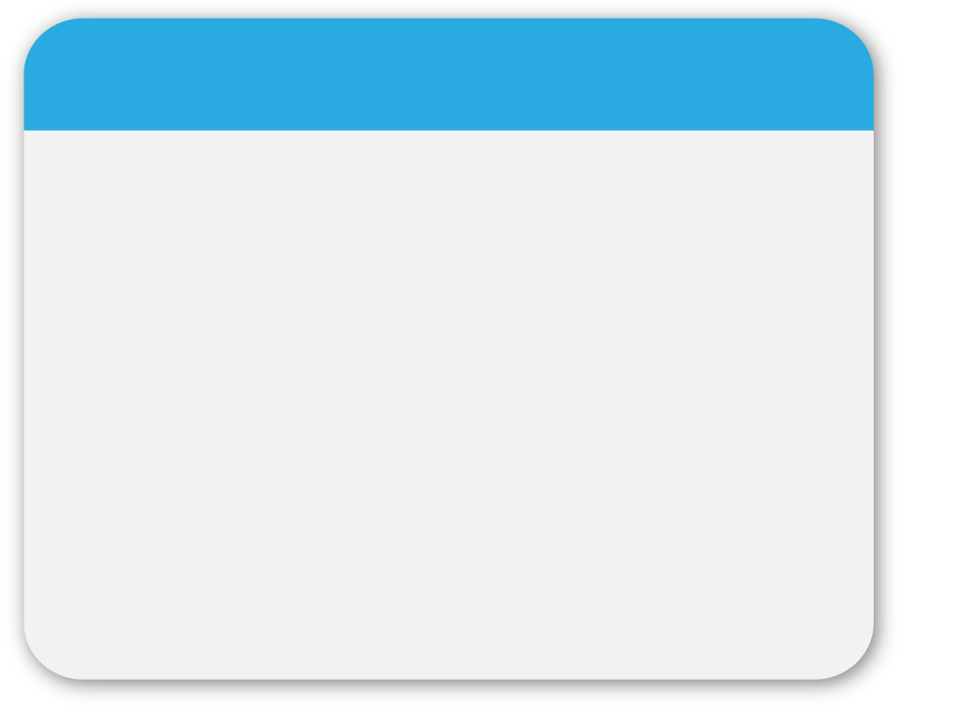
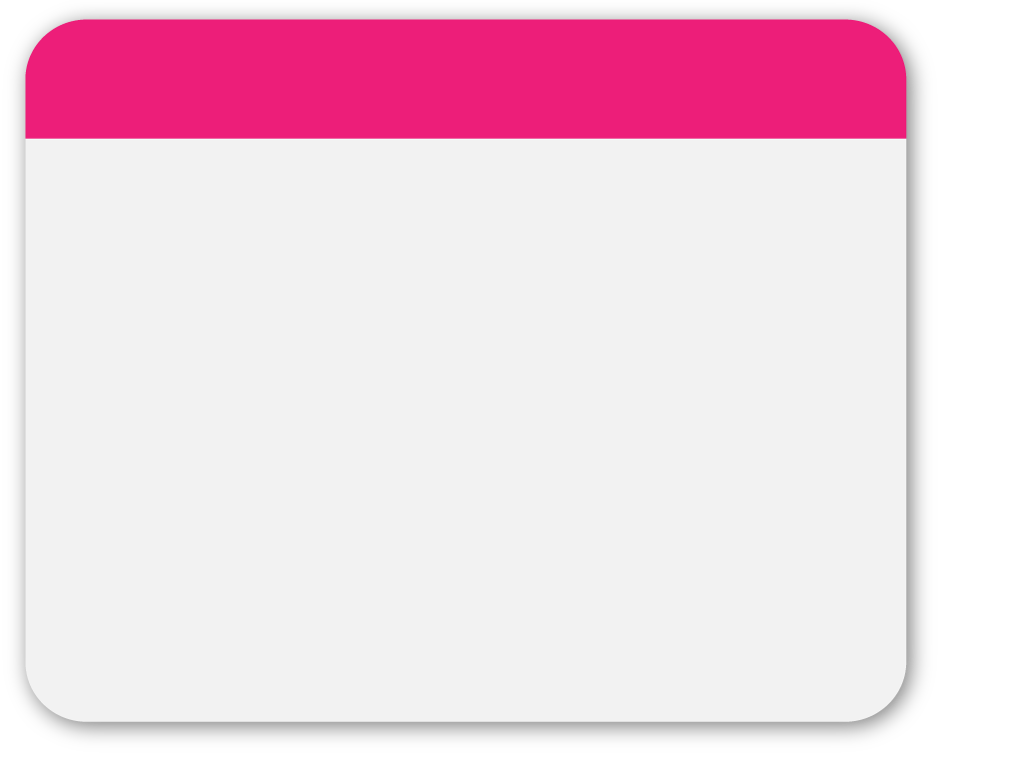
01
WINTER
Volume & surface area
of prisms
Template
Revision Lesson

Slide 2
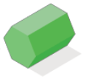
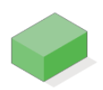
02
Prism / Not a prism?

Slide 3
03
Volume & Surface area

Slide 4
04
Surface Area & Volume

Slide 5
05
Connect 4

Slide 6
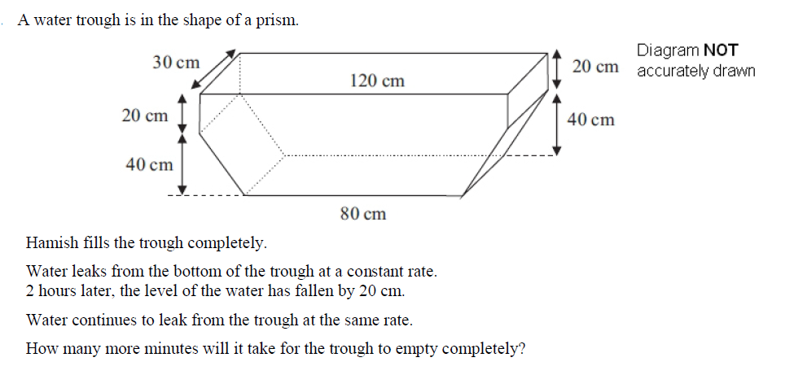
06
WINTER
Template

